Slide 1


Name of Capstone Project
Water Potability Prediction
biuld by: G VARUN
19/04/2026

Slide 2
Agenda:
Introduction
Problem Statement & Objective
Dataset Overview
Methodology
Model Building and Model Evaluation Metrics
Result
Conclusion
Future Scope

Slide 3
Introduction:
. Water quality is essential for human health
. Machine Learning helps in fast prediction
. Manual testing is time-consuming
. Need for automated prediction system

Slide 4
Problem Statement:
. Difficulty in quickly determining water safety
. Large amount of unsafe water sources
. Manual testing is costly and slow
Objective:
Predict water potability using ML
Improve decision-making
Build a user-friendly prediction system

Slide 5
Dataset Overview:
. Total Samples: 3,276
. Contains water quality parameter:
>>> pH, Hardness, Solids, Chloramines, Sulfate, Conductivity, Organic Carbon, Trihalomethanes
. Features: 10 columns
. Target: Potability
. 0 → Not Safe
. 1 → Safe
. Dataset contains real water quality measurements

Slide 6
Methodology
Data Collection
Data Cleaning
EDA-Exploratory Data Analysis
Feature Engineering

Slide 7
Data Collection
The dataset was collected from publicly available sources containing water quality measurements
It includes 3,276 samples with chemical features and a target variable (potability) for prediction
Data Cleaning
Missing values in pH, Sulfate, and Trihalomethanes were handled using median imputation
Checked and handled any duplicate records to ensure data accuracy
The dataset was cleaned by ensuring all features were properly formatted and ready for model training

Slide 8
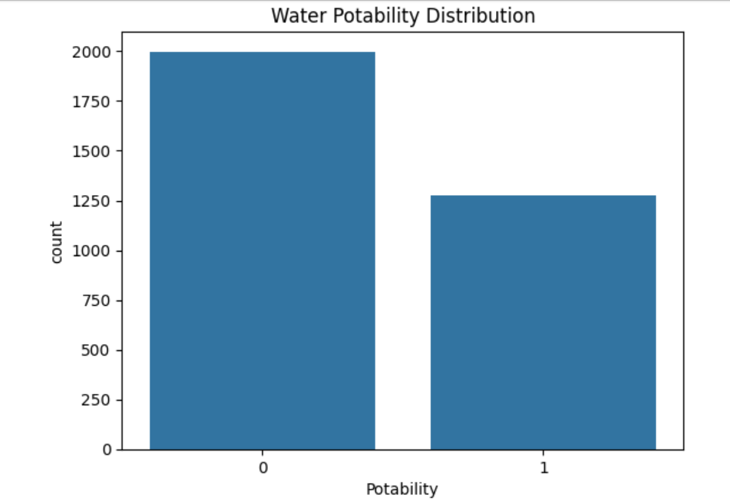
EDA (Exploratory Data Analysis)
. Performed Exploratory Data Analysis to understand dataset
. Identified missing values in multiple columns

Slide 9
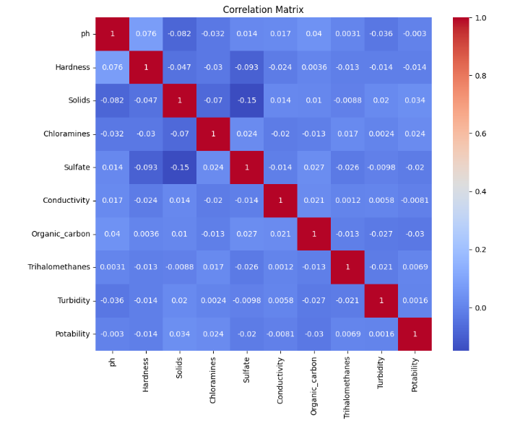
EDA (Exploratory Data Analysis)
A heatmap is used to visualize the correlation between different features in the dataset.
It uses color intensity to show the strength and direction of relationships, helping identify patterns or dependencies between variables.

Slide 10
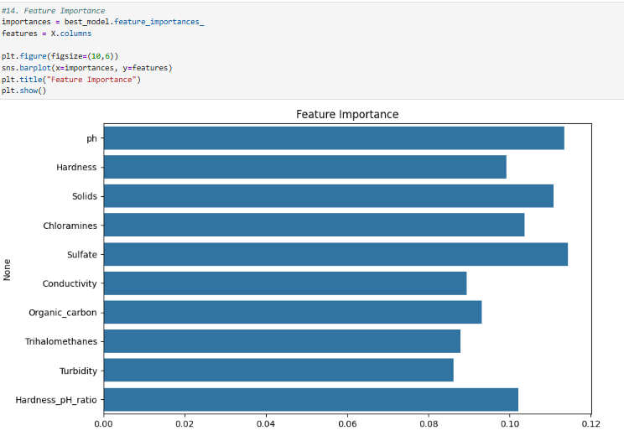
Feature Engineering
Feature engineering shows how much each feature contributes to the model’s prediction, highlighting which variables have the most influence on the outcome.

Slide 11
Model Building
Algorithm Used:
Data split into training (80%) and testing (20%) sets
Applied feature scaling using StandardScaler
Trained multiple models: SVM, Random Forest, KNN, Decision Tree
Each model learned patterns from training data
Predictions were made on unseen test data

Slide 12
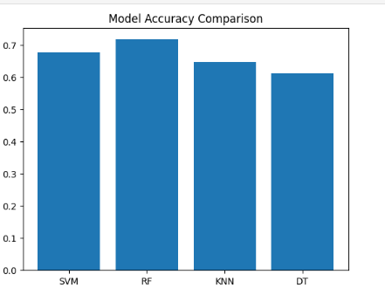
Model Accuracy Comparison
. Compared accuracy of all models to find the best performer
. Random Forest achieved highest accuracy (72%)

Slide 13
Result
The Random Forest model achieved the highest accuracy of 72%, making it the best-performing model among all. Other models like SVM, KNN, and Decision Tree showed comparatively lower performance. The Random Forest model produced fewer prediction errors and gave more reliable results. Model performance improved after handling missing values and class imbalance. Overall, the final model effectively predicts water potability based on input features.
Accuracy: 0.94
Precision: 0.96
Recall: 0.87
F1-score: 0.91

Slide 14
Conclusion
The project demonstrates that machine learning can effectively predict water potability using multiple features. Among all the models, Random Forest performed the best with the highest accuracy and reliability. The results show that no single feature determines water quality, but a combination of features improves prediction. This system helps reduce manual effort and provides faster decision-making. Overall, the model can be used as a supportive tool for water quality assessment.
. Machine learning helps in quick water quality prediction
. Reduces time and effort
. Useful for public health and environment

Slide 15
Future Scope:
The project can be further improved by using larger and more diverse datasets to increase accuracy. Advanced techniques like deep learning can be applied for better prediction performance. The model can be integrated with real-time water quality sensors for live monitoring. It can also be developed into a web or mobile application for easy access. In the future, this system can support smart water management and public health systems.
. Improve model accuracy with more data
. Deploy as web/mobile application

Slide 16
Questions ?

Slide 17
Name of Capstone Project
Thank You

